Slide 1
Restaurant management system
CAPSTONE PROJECT
Presented By:
Rajamahaguru M – 2021311030
Department Of Applied Science And Technology
ACTech , Anna University.

Slide 2
OUTLINE
Problem Statement
Proposed System/Solution
System Development Approach
Algorithm & Deployment
Result
Conclusion
Future Scope
References

Slide 3
Problem Statement
The existing manual billing system introduces delays for customers and operational inefficiencies within the organization, underscoring the necessity for enhancement. Adopting a computer-based billing system offers an opportunity to optimize resource utilization. This system simplifies data entry for client, employee, and payment information, streamlining record management and meeting organizational data requirements. Key drawbacks of the current approach include:-
Restricted flexibility in data modification-
Dependency on manual operator oversight-
Excessive paper consumption-
Challenges in accessing information promptly-
Difficulties in maintaining systematic records-
Paper waste

Slide 4
Proposed Solution
The Restaurant Management System (RMS) is a software solution designed to make restaurant billing faster and easier. With its intuitive interface, staff can quickly process customer bills, reducing wait times. RMS is capable of handling large amounts of data, allowing it to efficiently store and retrieve information such as billing history, reservations, and staff details.
This desktop-based system is designed for ease of use and requires minimal paperwork. It automates key tasks like bill calculation and discount application, reducing errors and speeding up the billing process. Because all data is stored digitally in a secure database, there's no risk of losing important information, and the need for manual record-keeping is greatly reduced. RMS helps restaurants operate more efficiently, ensuring a smoother experience for customers by streamlining critical operations like billing and reservations.

Slide 5
System Approach
Developing a Python-based restaurant management system involves a systematic progression, meticulously structured into the following phases:
*Requirements Analysis*: Conduct a comprehensive analysis to discern the system's needs thoroughly. This entails dissecting requirements related to menu composition, order handling workflows, reservation intricacies, inventory oversight, and comprehensive reporting capabilities.
2. *Modular Design*: Architect the system with a focus on modularity, delineating it into finely-grained modules. Each module should be tailored to address specific functions with precision, such as Menu Management, Order Processing, Reservation Handling, Inventory Control, and Advanced Reporting.
3. *Class Abstraction*: Employ meticulous class abstraction within each module to encapsulate entities and actions elegantly. Define intricate class hierarchies to represent various system components, including Menu Items, Orders, Reservations, and Inventory Items, fostering flexibility and maintainability.
4. *Relationship Mapping*: Thoroughly map relationships between classes/modules, orchestrating seamless interactions and dependencies. Articulate how orders are intricately tied to menu items, how inventory levels dynamically adjust based on orders, and how reservations seamlessly integrate into operational workflows.

Slide 6
System Approach
*Functional Implementation*: Implement robust methods and functions within each class/module, ensuring the flawless execution of diverse tasks. Develop sophisticated algorithms for menu management, streamlined workflows for order processing, efficient strategies for inventory control, and seamless processes for reservation management.
*User Interface Design*: Craft an intuitive user interface that reflects the sophistication of the underlying system architecture. Whether opting for a sleek command-line interface, an interactive graphical interface leveraging Tkinter or PyQt, or a user-friendly web interface powered by Flask or Django, prioritize user experience and accessibility.
*Thorough Testing and Refinement*: Conduct rigorous testing to validate the system's functionality and reliability comprehensively. Embrace an iterative refinement process, integrating user feedback and testing insights to continually enhance the system's robustness and performance.
*Comprehensive Documentation*: Document the system exhaustively, elucidating its architectural intricacies, functional capabilities, and usage guidelines. Cultivate meticulous documentation to empower future developers and users, facilitating seamless maintenance, and scalability endeavors.

Slide 7
Algorithm & Deployment
Revamped Approach to Restaurant Management:
*Efficient Menu Organization:* - Craft a structured menu item class detailing essential information such as name, price, and description. - Develop a dedicated system for managing menu items, facilitating easy addition, removal, and display.
*Streamlined Order Handling:* - Establish a robust order framework encompassing vital elements like order ID, selected items, and total price. - Implement seamless functionalities for adding items, precise price calculation, and efficient order processing.
*Smooth Reservation Management:* - Define a reservation structure incorporating key details like reservation ID, customer name, date, and table assignment. - Create an intuitive reservation management system allowing for easy reservation creation, availability checks, and cancellations.
*Effective Inventory Oversight:* - Introduce an inventory framework featuring crucial attributes such as item name, quantity, and price. - Develop comprehensive inventory management tools for effortless stock addition, quantity updates, and timely low stock notifications.

Slide 8
Algorithm & Deployment
*Insightful Reporting Mechanisms:* - Incorporate reporting functionalities to generate tailored reports such as sales and inventory reports, meeting diverse user needs.
*User-Friendly Interface Design:* - Design an intuitive interface enabling seamless interaction, offering options like command-line, web-based, or GUI interfaces to cater to user preferences.
*Flexible Deployment Strategies:* - Explore diverse deployment avenues including local deployment via PyInstaller, web-based deployment with Flask or Django, mobile app deployment using Kivy or React Native, containerization with Docker, and hybrid deployment for comprehensive operational coverage.

Slide 9
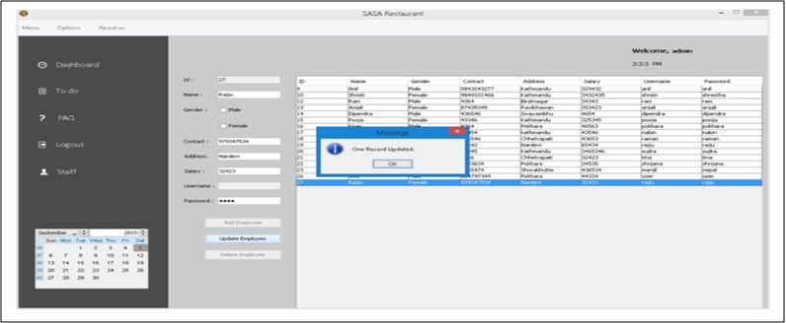
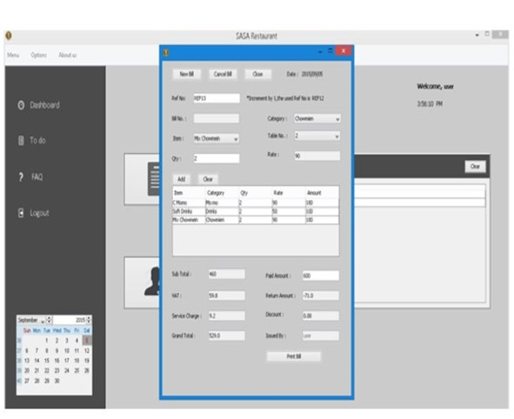
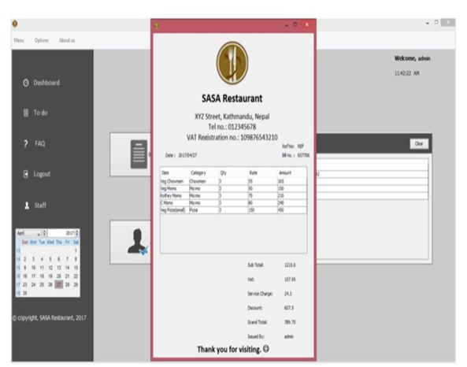
RESULT
Regarding the outcomes of the Restaurant Billing System, it effectively manages staff information, facilitates customer reservations, handles billing tasks, and more. Analyzing the results, the system allows for comprehensive staff management, including adding, editing, updating, and deleting staff information. Additionally, it supports reservation creation and cancellation, as well as printing bills for customers. The system outputs are illustrated in the figure below.

Slide 10
Conclusion
The documentation gives a comprehensive overview of the Restaurant Management system's structure and coding. Developing this program was a complex process, involving detailed analysis, thorough research, and specialized technical skills. Writing this report has been a rewarding experience, filled with insights gained from the challenging tasks required. Designing a system for a restaurant called for a combination of research and coding expertise, and creating a smooth operational flow demanded considerable time and effort.Despite the hurdles, the system was successfully completed with a well-designed structure and efficient workflow. The billing system was the most challenging component. Retrieving data from the database for billing purposes required complex SQL queries and managing multiple changes across various databases, which was time-consuming and required careful planning.Overall, this project offered valuable coding experience and highlighted the importance of effective time management and teamwork in software development.

Slide 11
Future scope
Restaurant management software (RMS) serves as a multifaceted solution for efficiently overseeing restaurant operations. From staff management to order processing, billing, menu administration, reservation handling, and beyond, it covers various essential functions. Looking to the future, the software is poised for enhancements and upgrades. Potential improvements like advanced inventory management, wireless tableside ordering and payment systems, real-time alerts, online ordering integration, and mobile management features hold promise for boosting revenue and optimizing costs.

Slide 12
References
Restaurant Billing System: https://www.scribd.com/doc/283903672/Online-Ordering-System-
Project Objective : https://www.scribd.com/document/36253350/04-Project-Billing-
System Scopes and Limitation: https://kungfumas.files.wordpress.com/2017/09/099.pdf
Feasibility study: http://www.slideshare.net/alok104/synopsis-on-billing-system-27487568
UML Diagram : https://www.techopedia.com/definition/3243/unified-modeling-language-uml/
Use Case Diagram: http://whatis.techtarget.com/definition/use-case-diagram
Class Diagram: http://searchmicroservices.techtarget.com/definition/class-diagram
Sequence Diagram : https://creately.com/blog/diagrams/sequence-diagram-tutorial/
ER Diagram: http://searchcrm.techtarget.com/definition/entity-relationship-diagram
Interfaces : https://www.youtube.com/watch?v=9K5sS7j5wWI

Slide 13
THANK YOU

